Slide 1
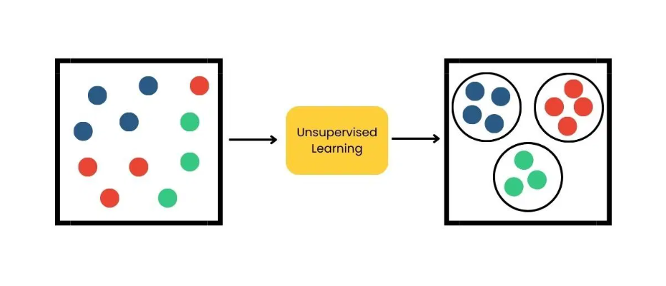
Unsupervised Learning
Jithender, Mukhesh, Nirav, Saketh & Srujana

Slide 2
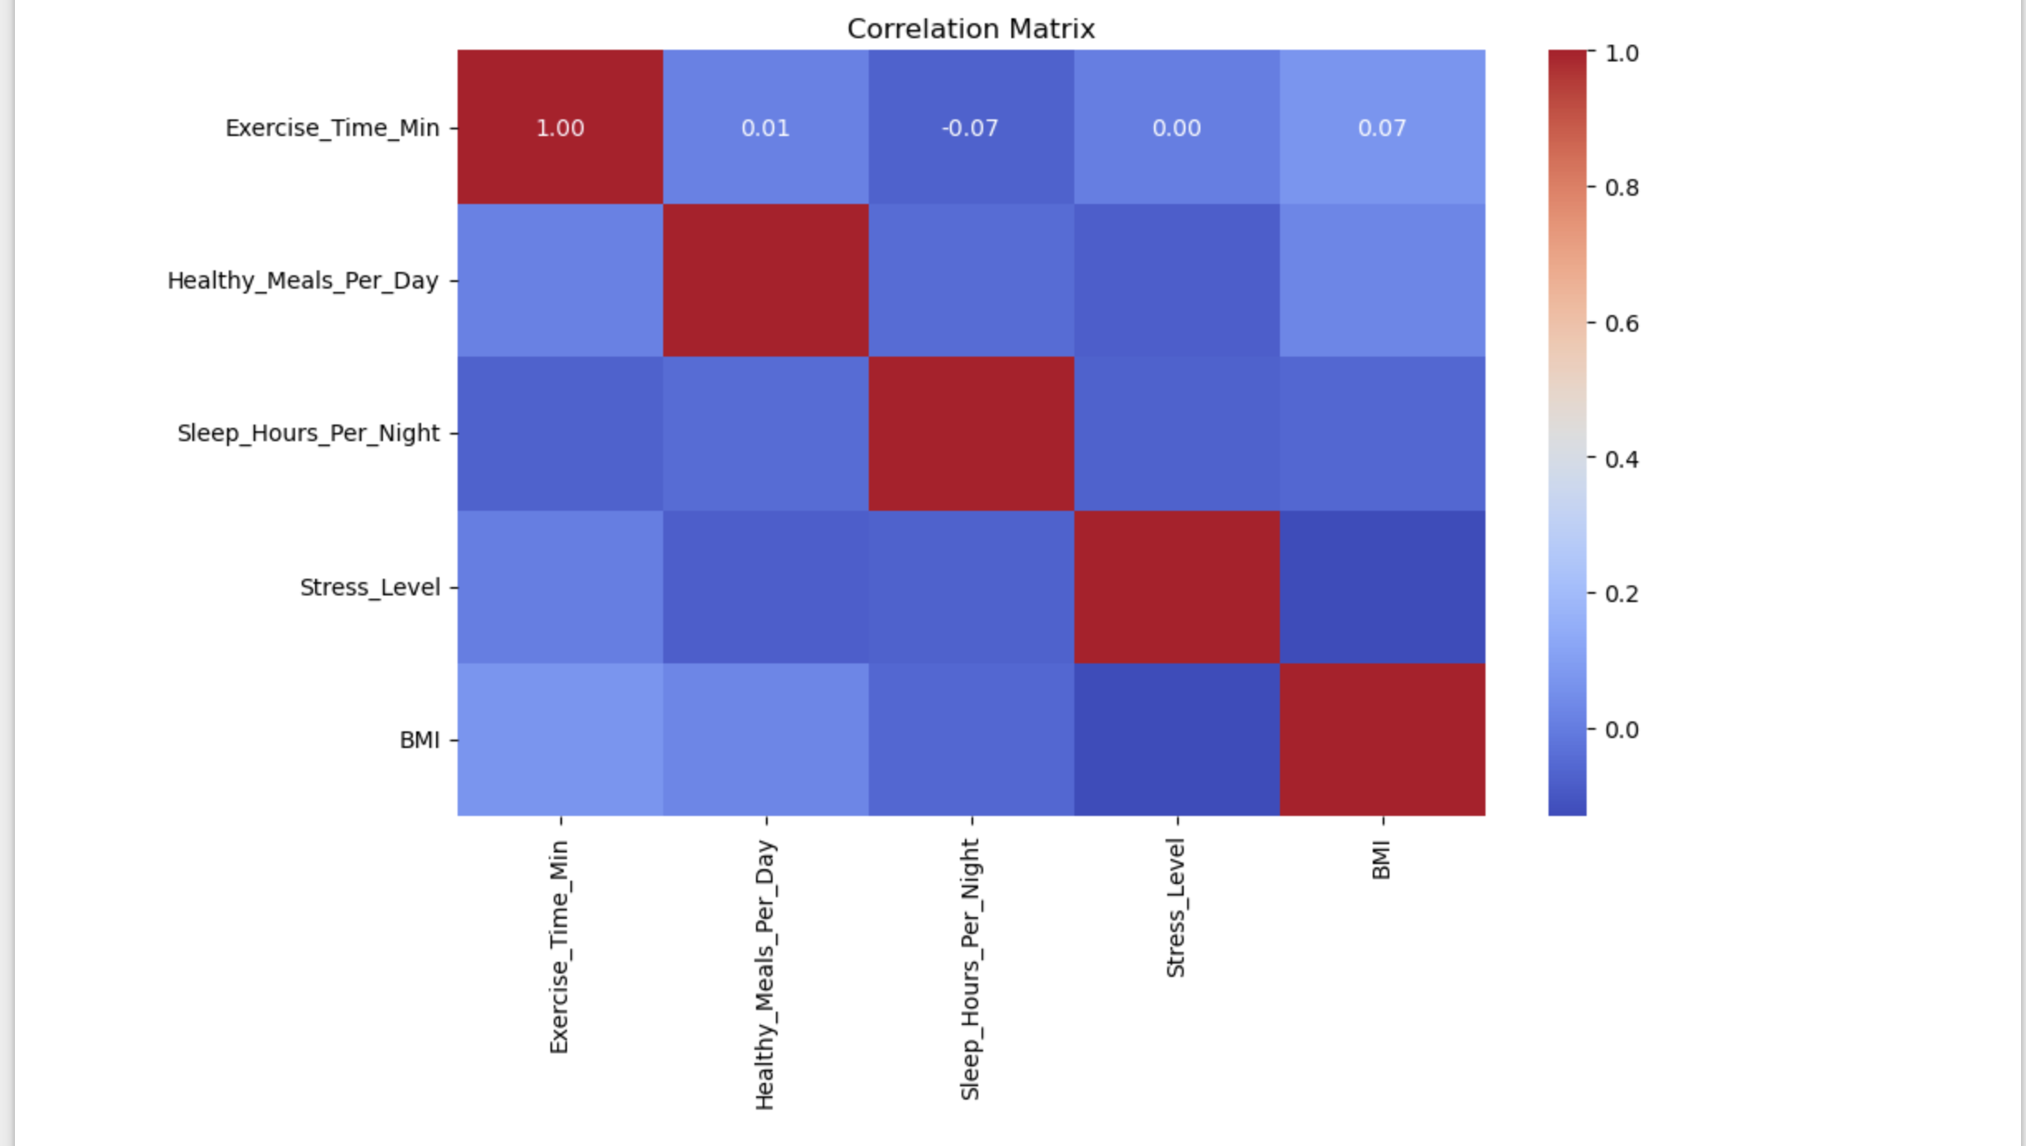
Exercise_Time_Min: shows no significant correlation with the other variables, with a slight positive correlation (0.07) with BMI and Stress_Level.
Stress_Level: has a slight positive correlation with BMI (0.2) and a slight negative correlation with all other variables.
Sleep_Hours_Per_Night and Healthy_Meals_Per_Day: have minimal correlations with other variables. The colors in the heatmap range from dark red indicating high positive correlation to dark blue indicating high negative correlation, with lighter shades representing weaker correlations.
Correlation Matrix
Correlation matrix heatmap, illustrating the correlation coefficients between different variables. The scale on the right ranges from -1 to 1, where:
1 indicates a perfect positive correlation.
0 indicates no correlation.
-1 indicates a perfect negative correlation.

Slide 3
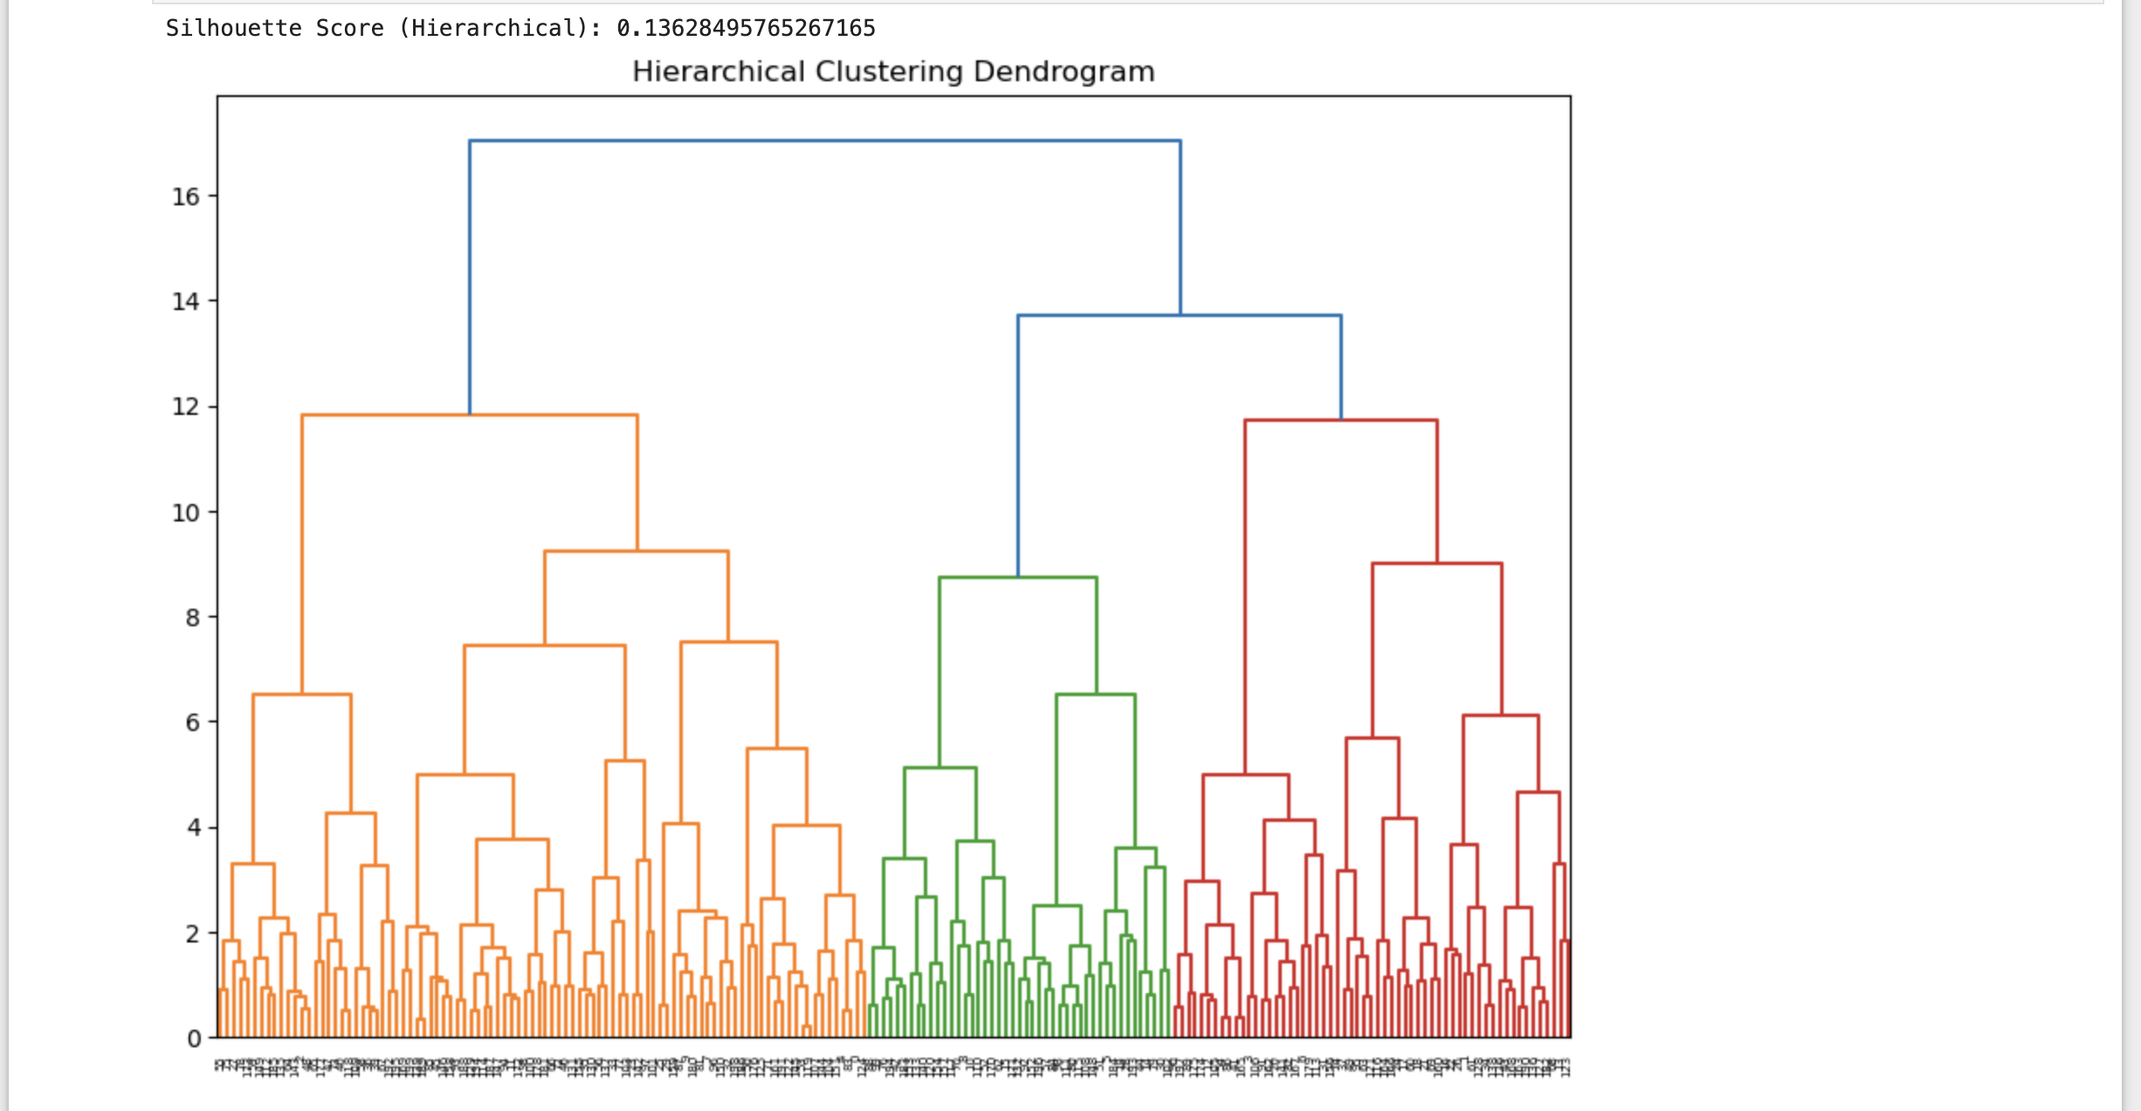
Hierarchical clustering
It visually represents the hierarchical relationships between data points using a tree structure. The different colors indicate distinct clusters formed at a particular distance threshold.
The Silhouette Score of 0.138, which is a measure of how well the clusters are defined. A score close to 1 indicates well-defined clusters, while a score close to 0 suggests that the clusters might overlap.

Slide 4
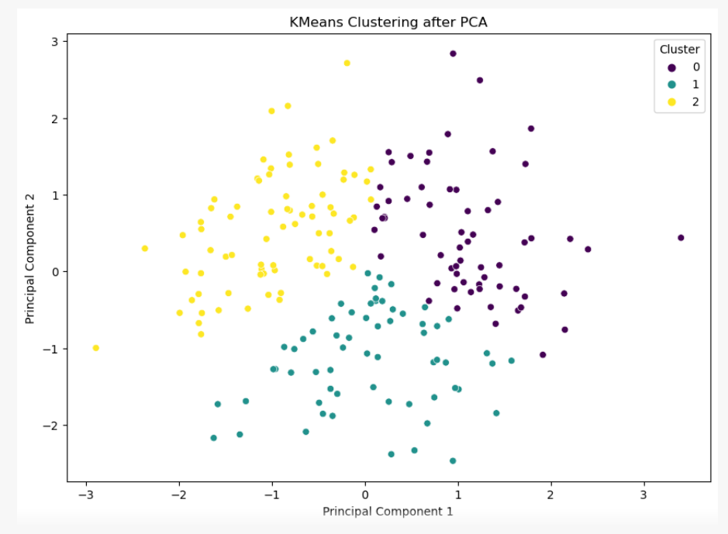
PCA with K-Means Clusters
Cluster 0 - Represents patients with balanced wellness profiles.
Cluster 1 - Represents patients who focus more on exercise and sleep but less on healthy meals.
Cluster 2 -Represents patients who focus more on healthy meals but less on exercise and sleep.

Slide 5
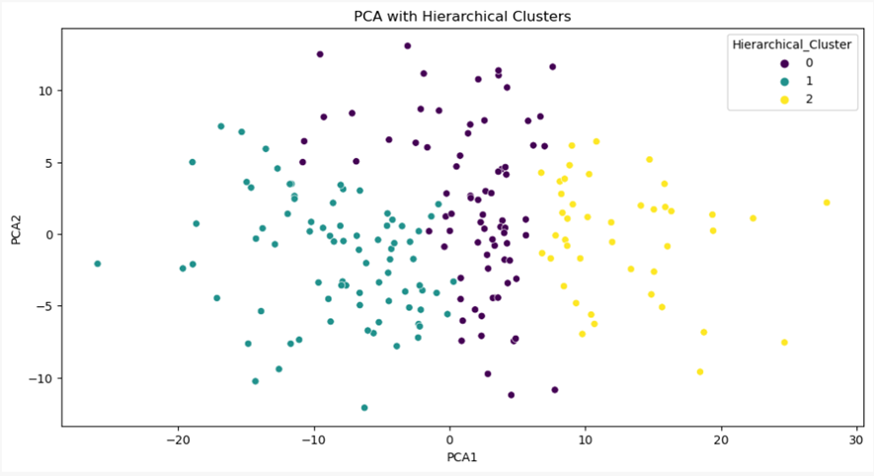
PCA with Hierarchical Clusters
The hierarchical clusters show similar patterns to the K-Means clusters, indicating consistency in the clustering results.

Slide 6
Interpretation
 | Before PCA | After PCA
Silhouette Score | 0.15 | 0.36
WCSS | 723.93 | 190.42

Slide 7
Recommendations
1. Personalized Wellness Plans
2. Efficient Resource Allocation
3. Predictive Health Interventions
4. Improved Health Outcomes

Slide 8
THANK YOU

